Slide 1
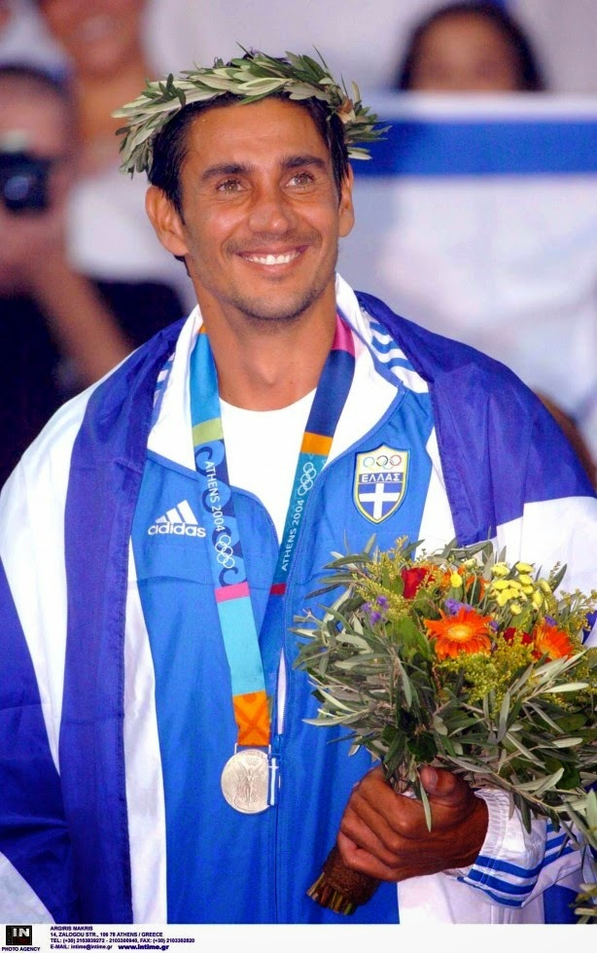
Nikos Kaklamanakis
Biography

Slide 2
Highest achievements
3 Times WORLD CHAMPION (1996, 2000, 2001)
2 Times VICE WORLD CHAMPION (1995,2003)
EUROPEAN CHAMPION (1994)
4 Times EUROPEAN BRONZE MEDALIST (1992,1993,1995,1998)
Gold OLYMPIC MEDALIST (Atlanta 1996)
Silver OLYMPIC MEDALIST in Athens 2004)
Gold medal on the pre-olympic test events (1994, 1995, 2002, 2003)
Bronze medal on the pre-olympic test event (1999)
Gold medal in Mediterranean Games (1993)

Slide 4
Gold Olympic Champion Champion of Life
By having in his windsurfing carrier the Best two medals (Gold in Atlanta 1996, Silver in Athens 2004) in the Olympic Boardsailing Class, the 6th place in Sydney 2000, and also by being 3 times World Champion, he is considered to be the best male Olympic board sailor up today.
In 1996 he was honored by the Greek Association of Sport Press. In the same year he was the last torch-bearers on Greek territory, while he holds the flag at the Closing Ceremony of Atlanta’s Olympic Games. He was also the flag bearer of Greece- the 1st athlete to enter into the Olympic stadium in Sydney 2000 Opening ceremony.

Slide 5
Create waves of change = to bring an ocean of opportunities
A special moment in his career is his sail boarding across the Aegean Sea in the summer of 1997-he realized the sailing Athens-Crete (200 nautical miles) in two days to support Greece in the Olympic Committee.
one month later September 1997 was member of the bid Committee for the 2004 Athens Olympic Games (Lausanne-Switzerland)

Slide 6
Light the Dream = Dream to WIN 2004 last torchbearer
Last but not least…
Nikos KAKLAMANAKIS (GRE), was the torchbearer who lit the cauldron at the Olympic stadium during the opening ceremony of the 28th Olympic Games.
This is the first time that such an honor has been bestowed upon any Greek Olympian and a sailor globally as well, so it was a truly unique moment.

Slide 7
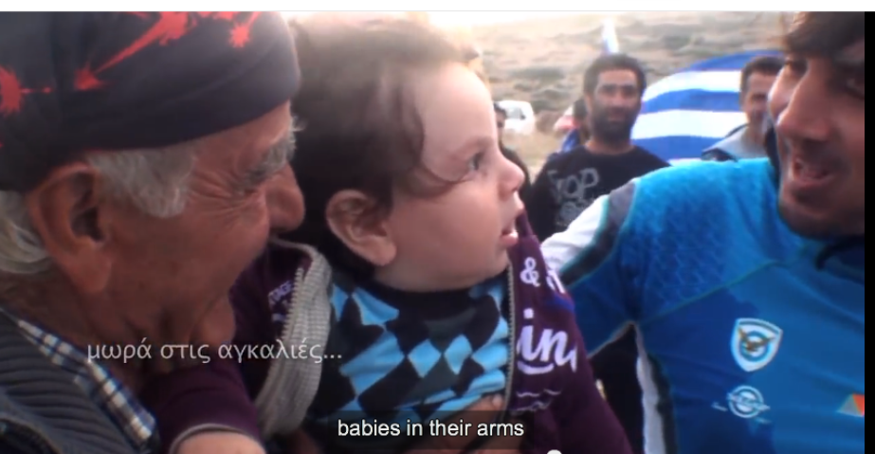
“The only battle the we loose is the one we don’t GIVE”
In 2011 he Made Aegean Crossing 280 nautical miles from the island of Andros to Island of Karpathos
To Revive faith and Inspire Greek people not to give up…

